Slide 1

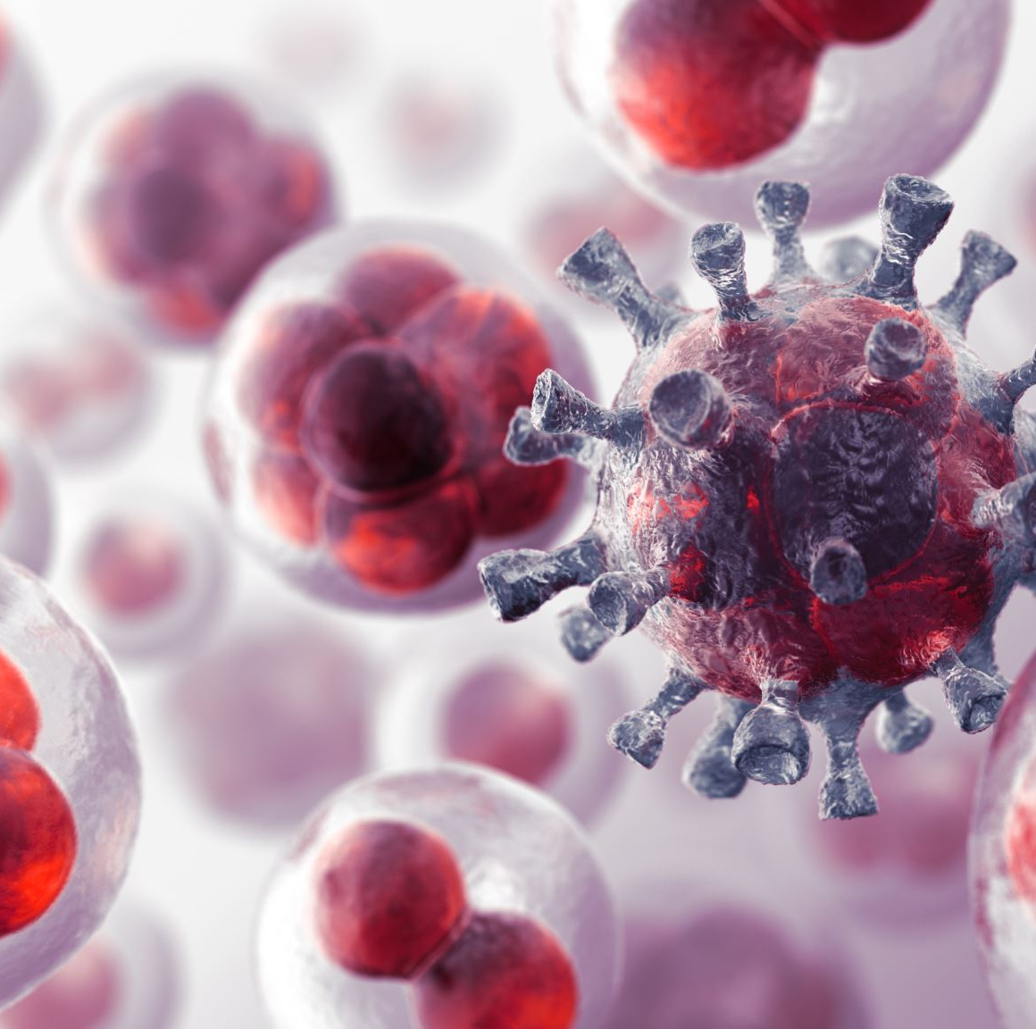

Corona Mutated
By Issa Habeeb

Slide 2

Description
You are in the year 2020 and Corona virus is spreading like wildfire!
You wake up and suddenly zombies-like creatures everywhere?
Sadly, looks like Corona virus has mutated to a much deadlier virus!
You know the only way to escape is to leave the country and live on an island.
Your best choice is to find helicopters or airports planes.

Slide 3
Character description
Two main characters: You and your dad.
You: A normal college student, making decisions, capable of driving, and shooting a weapon.
Dad: Looks after you and is willing to sacrifice himself for your survival.
Zombies: Human-like creatures who may have a missing arm or a leg, with appetize for blood.

Slide 4
Game map
Map is more of a rural environment, not a city.
Just your average neighborhood, normal homes with a garage.
Lives near gas station, police station, and bit further from an airport.
But zombies are destroying everything in their path!

Slide 5
uniqueness
There is randomness, which leads to replay-ability.
There is very rare way of winning.
Multiple paths a player could take to victory or loss.

Slide 6
Investment
Add graphics.
Hire developers.
Hire artists.
Add more details and expand the story.
Animations, physics, etc…

Slide 7
Code structure
Import library random and time.
Create re-useable functions, and main function.
Have conditionaLs in main function to satisfy different outcomes.
Implement a way to determine victory or loss.
Add a replay option.

